Slide 1

NDEJJE UNIVERSITY
FACULTY OF ENGINEERING AND SURVEY
BACHELOR OF ENGINEERING CIVIL
ACADEMIC YEAR: 2025/26
GROUP ONE MEMBERS
PROJECT REPORT
TITLE: AUTOMATED CLOSED TRAVERSE COMPUTATION, ERROR ADJUSTEMENT AND QUALITY CONTROL SYSTEM
APPLICATION ENVIRONMENT: PYTHON 3.X (GOOGLE COLAB/STREAMLIT)
NAME | REG NO
WACHA STEPHEN MAXWEL | 25/1/324/D/2339
KANYIKE GLEN | 25/1/324/D/546
MUGERWA EMMANUEL | 25/1/324/D/569
NAKAWAFU SALIMAH | 25/1/324/D/1316

Slide 2
1. PROBLEM IDENTIFICATION
In geodetic surveying, civil engineering, and land boundary mapping, establishing control networks via Closed Loop Traversing is a primary task. Field surveys measure horizontal distances and interior angles across interconnected traverse control stations. However, field observations inherently contain systematic and random errors arising from atmospheric conditions, instrument imperfections, target alignment tolerances, and environmental factors. Manual Computation Complexity: Hand-calculating polygon angular misclosures, azimuth propagation, latitudes, departures, and Bowditch/Transit corrections for multi-leg control networks is labor-intensive and highly prone to calculation errors. Real-Time Quality Control Verification: Field teams require rapid verification of Linear Misclosure and Relative Precision Ratios (e.g., 1:10,000 for cadastral boundaries) to determine whether network tolerance standards are satisfied prior to leaving the survey site. Data Standardization & CAD Integration: Raw field measurements must be dynamically reduced, visually mapped, and exported into structured formats (CSV, high-resolution boundary plots, and text summaries) for CAD integration and office reporting.

Slide 3
2. OBJECTIVES
To eliminate manual calculation errors in closed polygon surveying by building an automated pipeline to process raw distances and interior station angles, execute rigorous angular and linear adjustments, perform automated quality control checks, and visually plot adjusted control station geometry

Slide 4
3. METHODOLOGY
To overcome manual calculation limitations and streamline quality assurance, an Automated Closed Traverse Computation System was engineered in Python. The system fully automates the geometric reduction workflow: Automated Angular Adjustment: Evaluates measured interior horizontal angles against theoretical sum (N − 2) × 180° and evenly distributes angular misclosure across all stations. Azimuth Propagation: Calculates adjusted forward bearings/azimuths dynamically across all traverse lines from an initial benchmark orientation. Component Balancing & Error Adjustment: Derives raw Latitudes (ΔY = Distance × cos θ) and Departures (ΔX = Distance × sin θ), then balances linear misclosures using either Bowditch (Compass Rule) or Transit Rule techniques. Coordinate Mapping & Automated QC: Computes precise Easting (X) and Northing (Y) coordinates for control stations and automatically validates precision ratios against target survey standards. Multi-Platform Dashboard: Offers interactive web-ready dashboards using Streamlit and Google Colab Jupyter Widgets with real-time plotting and one-click data downloads

Slide 5
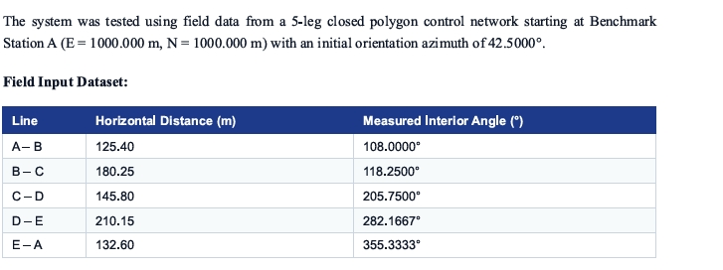
4. TESTING, DATA REDUCTION & EXPERIMENTAL RESULTS

Slide 6
5. CHALLENGES ENCOUNTERED & PROBLEM RESOLUTION
Trigonometric Quadrant Signs: Standard Python math/NumPy functions operate strictly in radians. Azimuths expressed in degrees required systematic conversion using np.radians() to prevent quadrant inversion.
Zero Misclosure Boundary Conditions: Applying Bowditch corrections when the sum of latitudes or departures crossed zero caused zero-division errors. Added conditional safeguards and absolute sum terms for Transit rule calculations.
UI Deployment Compatibility: Transitioned from notebook-only widgets (ipywidgets) to a production grade Streamlit application (app.py) enabling full web deployment

Slide 7
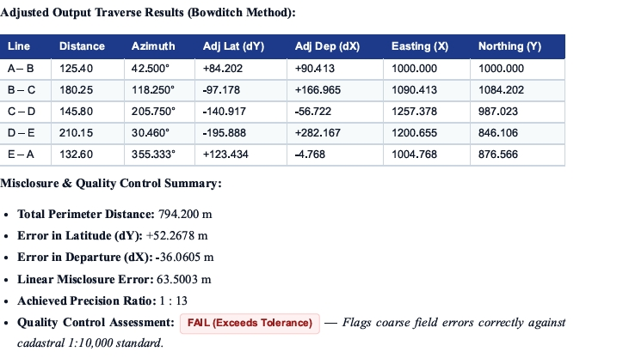
TESTING, DATA REDUCTION & EXPERIMENTAL RESULTS

Slide 8
6. CONCLUSION
The automated closed traverse computation system successfully bridges the gap between field survey data acquisition and high-precision geometrics processing. By automating angular balancing, coordinate generation, and Bowditch/Transit distribution, it eliminates manual computational errors and significantly accelerates field reporting workflows.

